Slide 1
ART 1600 – The Aesthetics of Architecture, Interiors, and Design Matthew Ziff, Associate Professor Spring Semester 2017
A Vocabulary of Design 3
Design Concepts & Vocabulary

Slide 2
The Aesthetics of Architecture, Interiors and Design is connected with:
the form, function, technology and material of the piece
the cultural context in which the piece is proposed/designed
the cultural context consisting of:
social issues, political issues, economic issues, religious issues.
the geographic, climatic context of where the piece is located
the audience for who (whom) the piece is intended:
public or private? seen/experienced by many or by few?

Slide 3
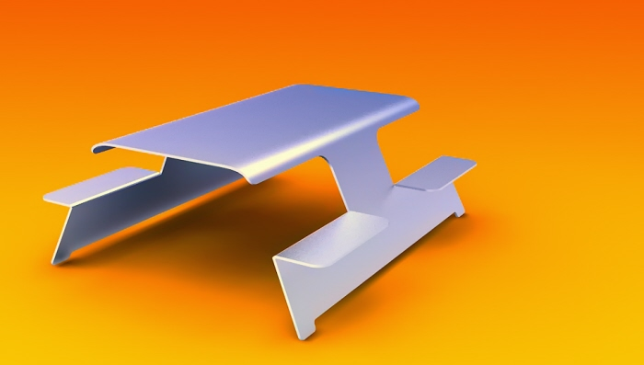
Form, function, technology and material of a proposed element, such as furniture
Furniture Designed by Nathan Mills, Toronto, Canada

Slide 4
Design and Culture, a journal dedicated to investigating the way that design impacts and is impacted by culture, nurturing the study of design history and criticism, and encouraging better communication between the professional and academic design communities.

Slide 5
Geographic Context matters

Slide 6
Raised up on stilts to keep it safe from flooding, a common technique in the region, the Lazika Municipality Building is comprised of three distinct volumes that are interconnected. The base will hold the public service functions, the curved glass building in the middle is a wedding hall. On top, a rectilinear block with a perforated metal screen will be used as an office building. A red glass elevator connects the various levels. Lazika Municipality Building, Georgia Lazika Municipality (Russia)

Slide 7
Lazika Municipality Building designed by Architects of Invention

Slide 8
Lazika Municipality Building designed by Architects of Invention

Slide 9
Lazika Municipality Building designed by Architects of Invention Web Page Showing the Lazika Municipality Building

Slide 10
Who is the Audience, User?

Slide 11
User Centered Design
“An approach to design that grounds the process in information about the people who will use the product.”
Usability Professionals Association
“A design philosophy and a process in which the needs, wants, and limitations of end users of a product are given extensive attention at each state of the design process.”
Wikipedia
“User centered design(UCD) is an approach for employing usability. It is a structured product development methodology that involves users throughout all states of …development in order to create (products) that meet users’ needs.”

Slide 12
Design can be responsive to varied, diverse, ways of living. “When you look closely no one is normal.” Dr. Pompeo Martelli, Director Centro Studi e Ricerche Museo della Mente, Rome, Italy

Slide 13
The concept of an ‘Expert’
Good design is not just ‘opinion’ but the opinions of good designers and good critics do matter.
The concept of an ‘expert’ is important, and an essential aspect of surviving as a human.

Slide 14
If you have a question about physics do you trust and believe Albert Einstein (left) or Some Guy (right)?

Slide 15
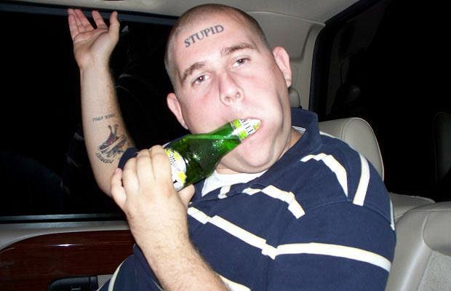
If you want to understand a piece of architecture do you listen to Frank Gehry (left) or Some Guy (right)?

Slide 16
What is an ‘Expert’?
Someone widely recognized as a reliable source of technique or skill whose faculty for judging or deciding rightly, justly, or wisely is accorded authority and status by their peers or the public in a specific defined domain. (such as music, cooking, or architecture)

Slide 17
An Expert
An expert, more generally, is a person with extensive knowledge or ability based on research, experience, or occupation and in a particular area of study.
Experts are called in for advice on their respective subject, but they do not always agree on the particulars within a field of study.

Slide 18
‘Good’ design is not absolute
Within the realm of aesthetics, architecture, interiors, and design, there are widely held views, beliefs, orientations, and guiding ideas, sometimes called ‘principles’.
Many of these are consistently recognized across long periods of time.
On the other hand, many change with time.
What is meant by ‘good design’ changes over time and changes with context but some central attributes last longer than others.
‘Good’ design is not absolute. Humans are not absolute, and human culture is not absolute: it changes, in response to scientific discoveries, cultural changes, political changes.

Slide 19
What is a Principle?
In the realm of designing a principle can be thought of as:
an essential element, constituent, or quality, especially one that produces a specific effect.

Slide 20
Basic Principles of Designing
Characteristics such as these are long standing useful elements in understanding and appreciating works of design:
Texture
Proportion
Scale
Harmony
Rhythm
Balance
Unity and Variety
Emphasis

Slide 21
To enhance your understanding of design, architecture, and interiors, try to look for these principles as they might be used in a space, place, or object.
Just as music relies on principles of
melody
harmony
rhythm
Design relies on principles to build a coherent and interesting space, place, or object.

Slide 22
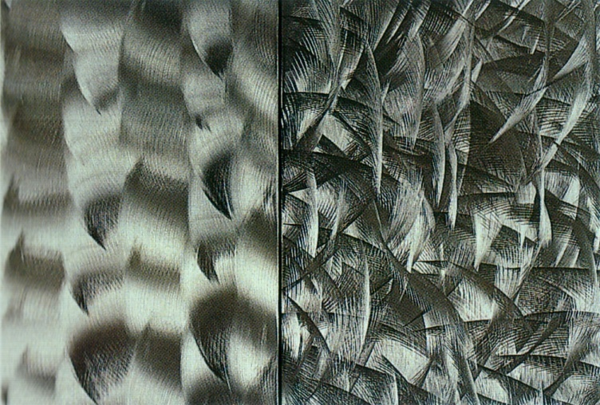
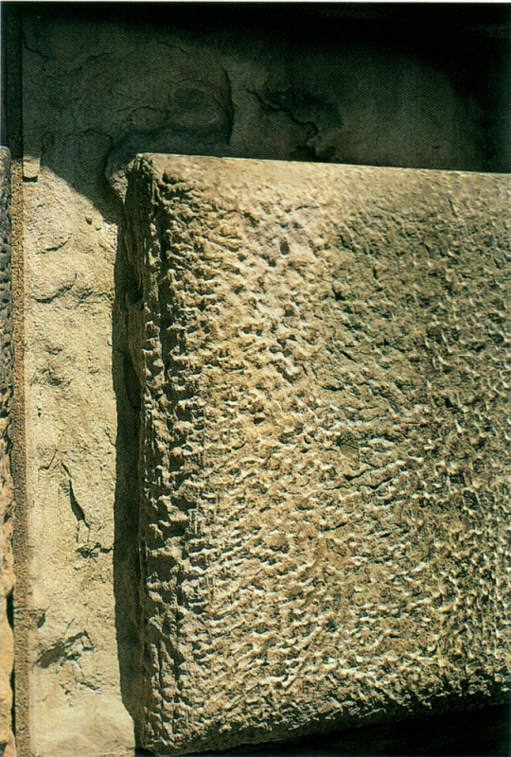
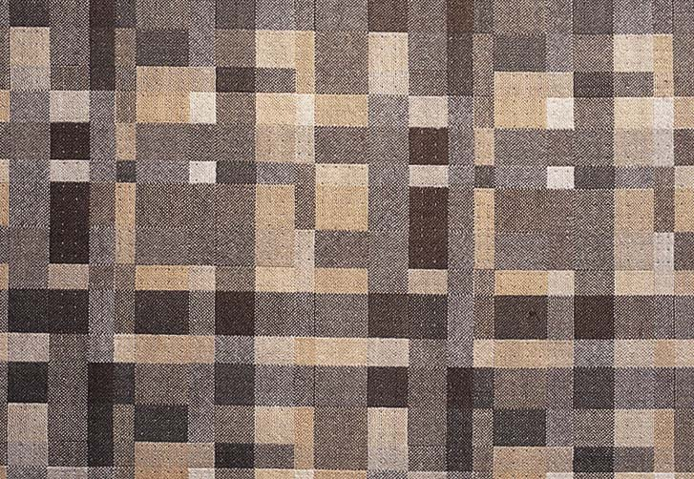
Language that articulately describes the visual world around us. Texture
Texture is based on the three dimensional tactile quality of a surface. Texture is a very small form of pattern.
Surface Characteristics: Smooth, Rough, Grainy, Woven, Soft, Hard, Cool, Warm….

Slide 23
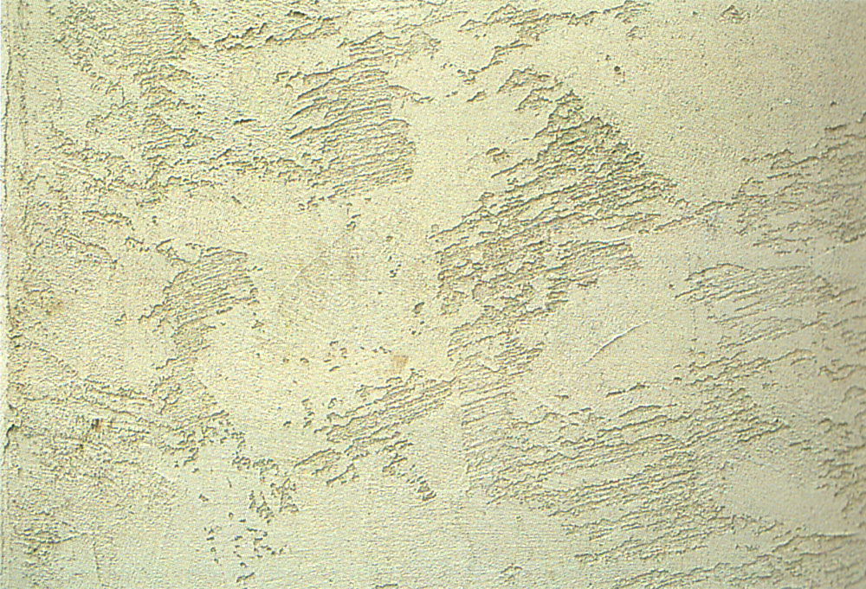
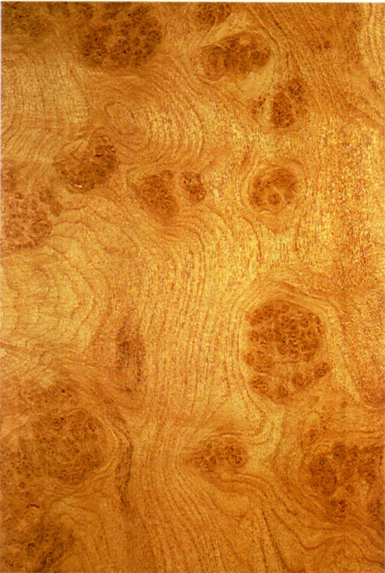
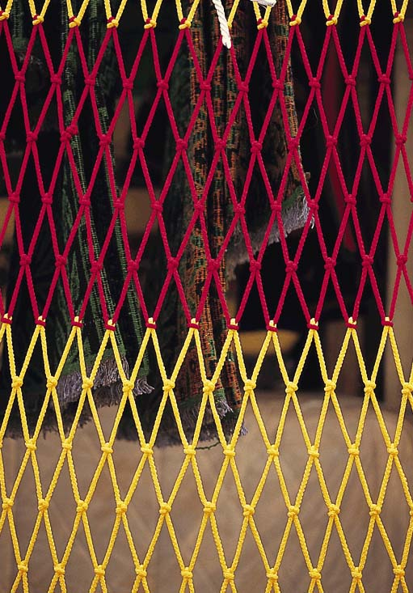
Texture
Physical Texture – Has a physical, tactile quality that is dimensional.
Visual Texture – is a illusory or only visible to the eye.

Slide 24
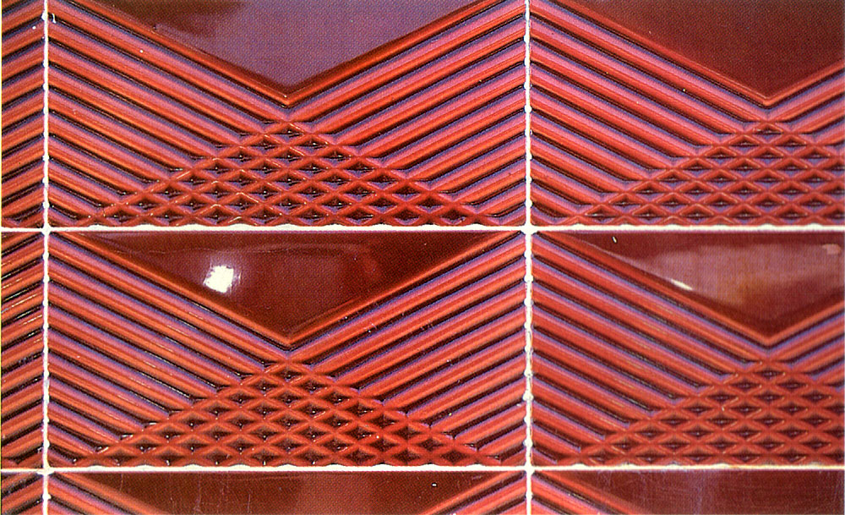
Texture
Scale and directional pattern create and effect the way we perceive texture.
The further the distance the smoother the texture will appear. (Reduces in scale.)

Slide 25
The brick wall has a smooth texture when we are far enough away for each individual brick to lose clear identity.

Slide 26
Less smooth as we get closer to the bricks. The bricks now become a ‘pattern’ more than a texture.

Slide 27
Texture: the fur Pattern: whiskers (this guy is an acorn expert!)

Slide 28
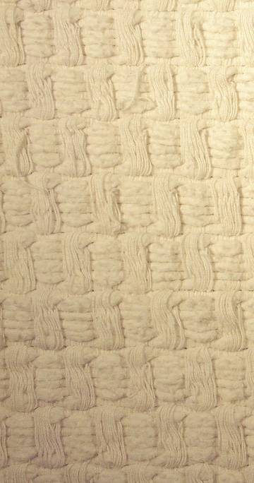
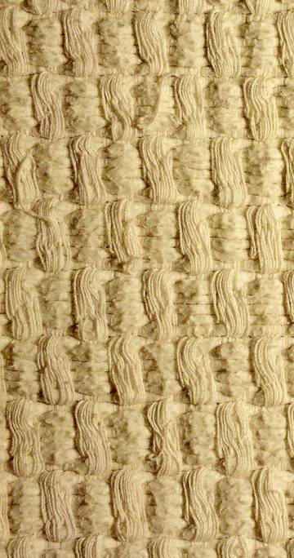
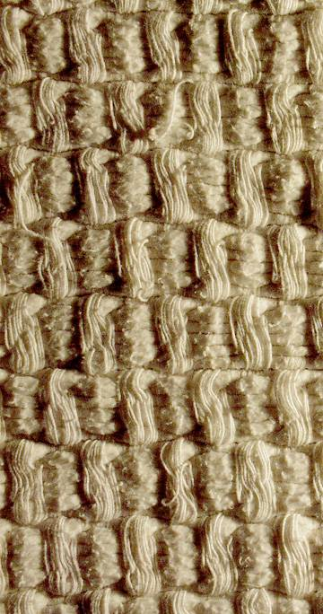
Texture and Light
The direction of light effects the visual depth of texture.
Light striking at an acute angle to the surface will enhance the depth of the texture. (Creates more shadows)

Slide 29
Texture & Light Photographs of a woven basket

Slide 31
Light from below: enhances the visual perception of the texture of the brick wall

Slide 32
Lighting from above This is called ‘grazing’ light

Slide 33
Brick wall in cloud cover daylight

Slide 34
Direct, straight on, lighting

Slide 35
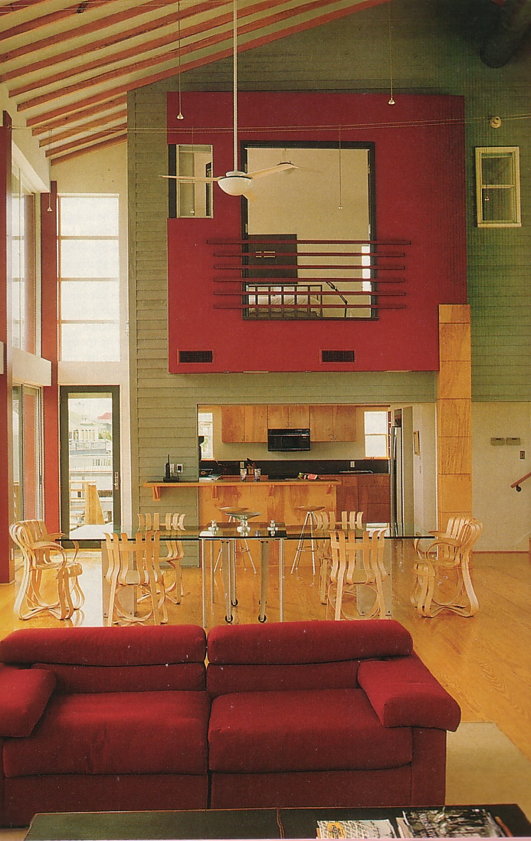
Texture and Contrast:
In the constructed environment different textures are used to emphasize or de-emphasize adjacent textures.
Contrast will enhance the perceived smoothness and roughness of other textures.

Slide 36
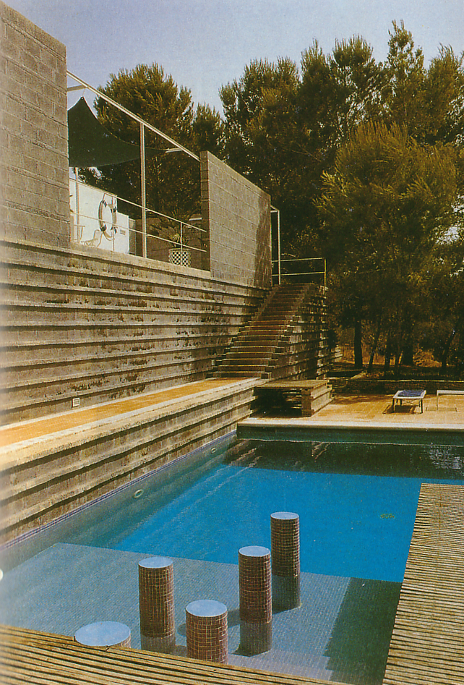
Texture
All materials have an inherent texture.
The combination of textures defines part of the experience of the space. (In combination with light, form, and color)
Textures and patterns can relate to the scale of the space.

Slide 37
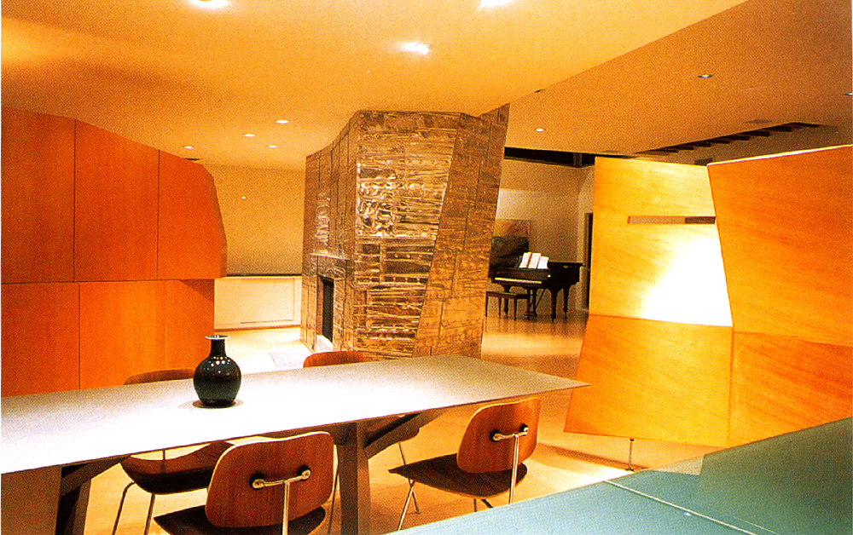
Texture
The combination of textures can create visual interest.

Slide 38
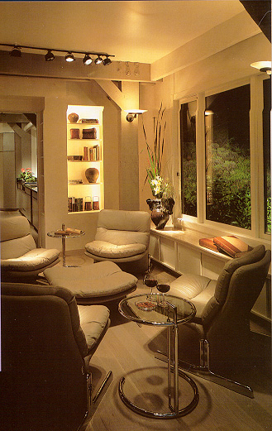
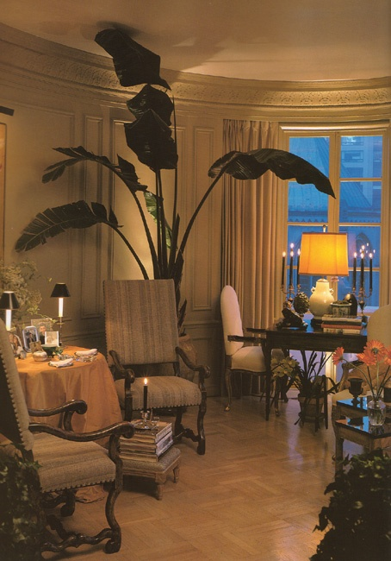
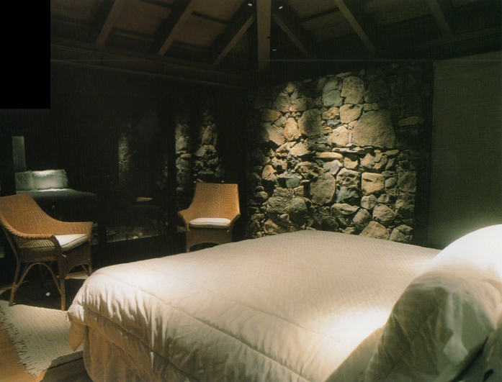
Architectural and Interior Lighting
Lighting reveals space, form, material, and experience in the built environment.

Slide 39
Lighting
The design of lighting can be divided into three broad categories:
Ambient (“General” overall lighting)
Task (light for specific “local” activities.)
Accent (Light for visual interest.)

Slide 40
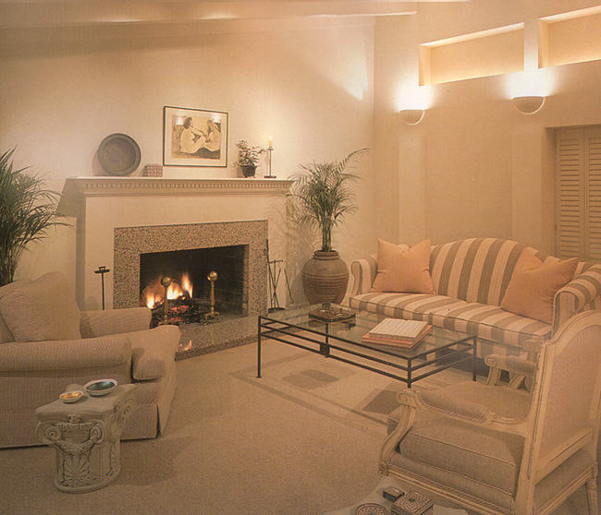
Lighting
Ambient (“General” overall lighting)

Slide 41
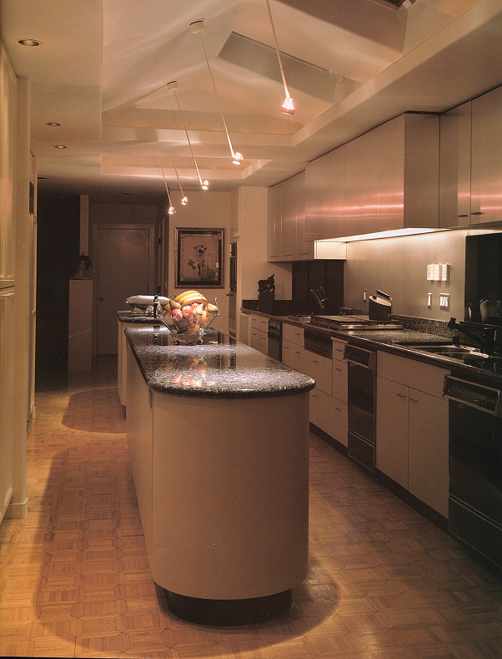
Lighting
Task (light for specific “local” activities.)

Slide 42
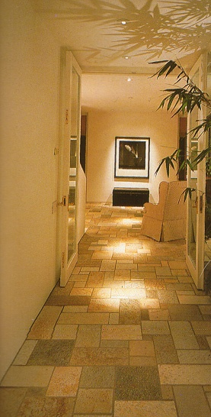
Lighting
Accent
(Light for visual interest.)

Slide 43
Light can be a significant architectural element within an interior space.
85 Broad Street New York City
2016 AL Design Awards: “Manus x Machina: Fashion in an Age of Technology”
Louvre Abu Dhabi: with interviews: 3:28 long
Louvre Abu Dhabi: video without the interviews: 2:49 long

Slide 44
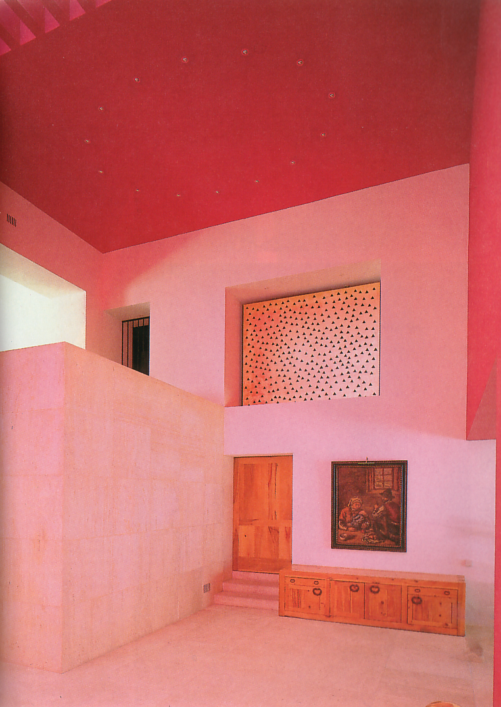
Design Principles
Creating Patterns and Relationships in Space With:
Proportion
Scale
Balance
Harmony
Unity and Variety
Rhythm
Emphasis
Patterns work together to make a whole.

Slide 45
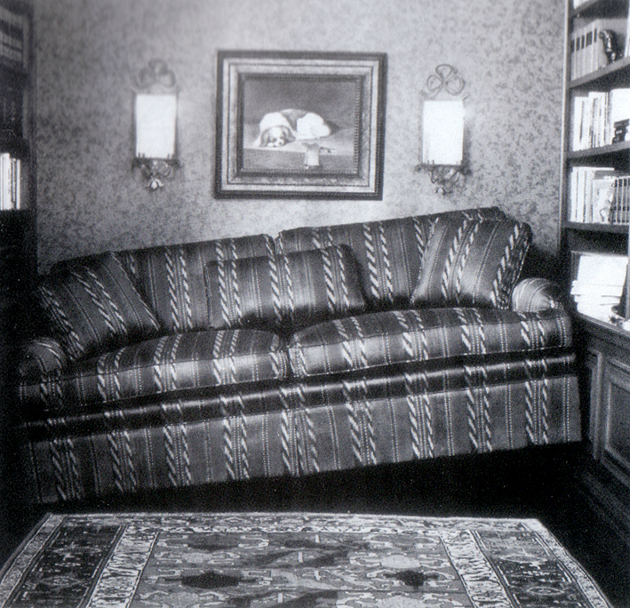
PROPORTION

Slide 46
Design Principles
Proportion
The apparent size of an object in relation to the other objects around it or the whole.
Large, small, thin, curved, edge, center, single, cluster….

Slide 47
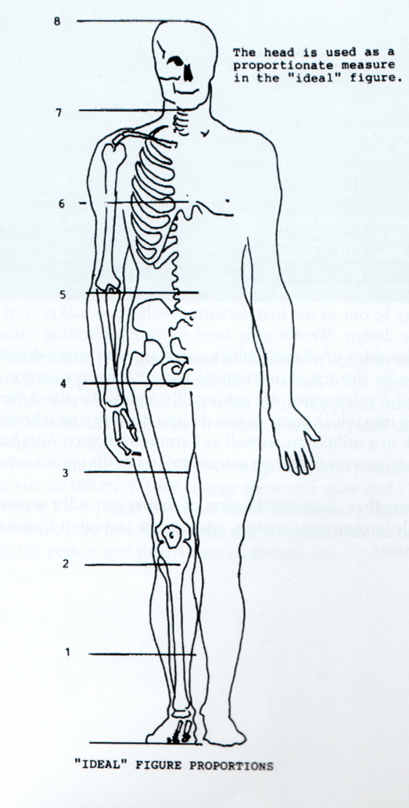
Design Principles
Proportion
The head may be used as a proportional element to understand the “ideal” human figure.

Slide 48
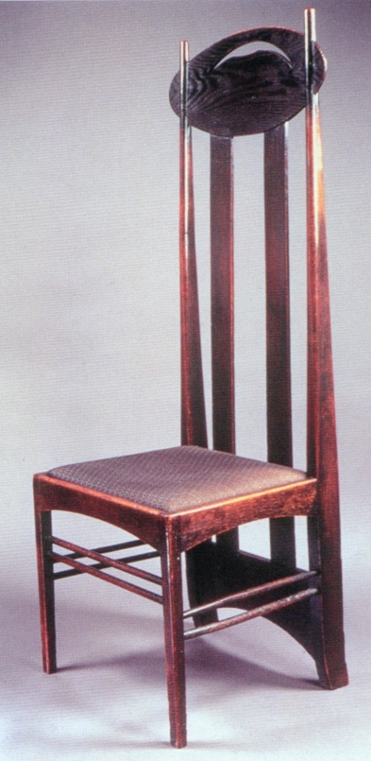
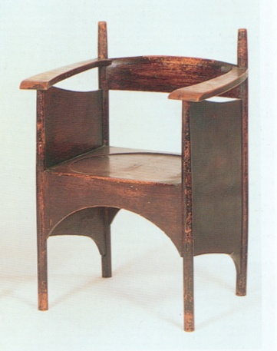
Design Principles
Proportion
Proportionally thin and squat chairs designed by Charles Rennie Mackintosh.
Design of the elements in the chair enhance the thinness and squatness.

Slide 49
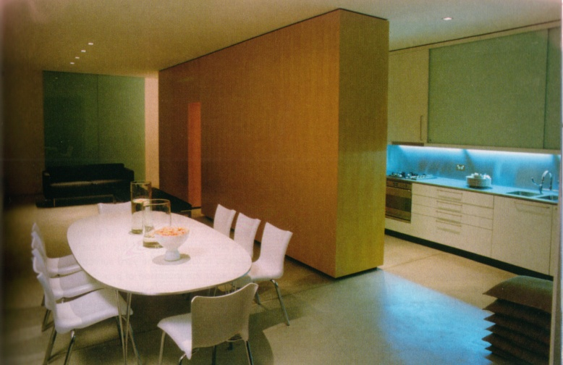
Design Principles:
Spatial Proportion
Proportionally thin, and visually delicate, furnishings contrasted with a thick, visually massive, wall.

Slide 50
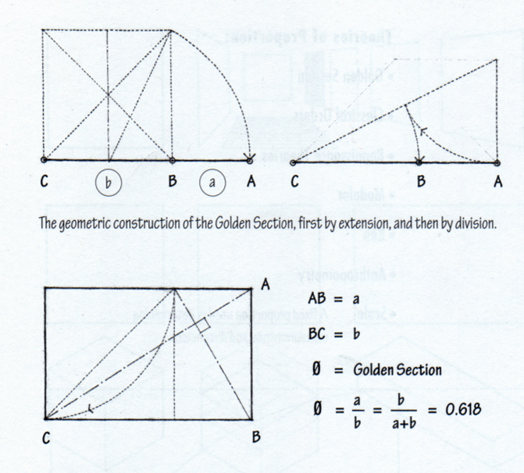
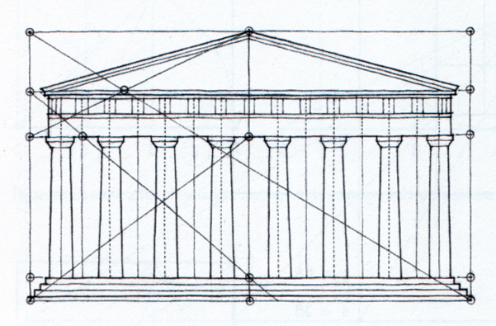
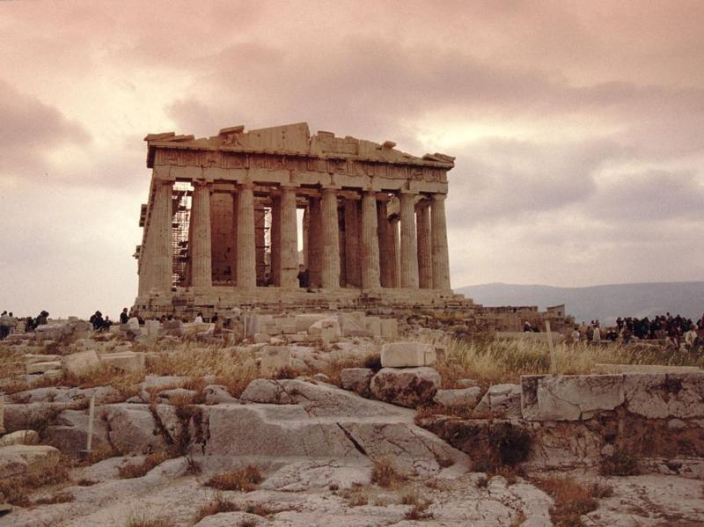
Design Principles
Mathematical Proportion
Mathematical relationships are used to create proportional relationships.

Slide 51
Design Principles
A proportion known as the ‘Golden Section’ has been used, and explored, since the time of the ancient Greeks. There are natural elements that have close, but not exact, correspondences with this proportion.
An Italian mathematician called Fibonacci (Leonardo of Pisa, 1201 AD) discovered a mathematical series that uses the same proportion, of 1: 1.618, as the Golden Section.

Slide 52
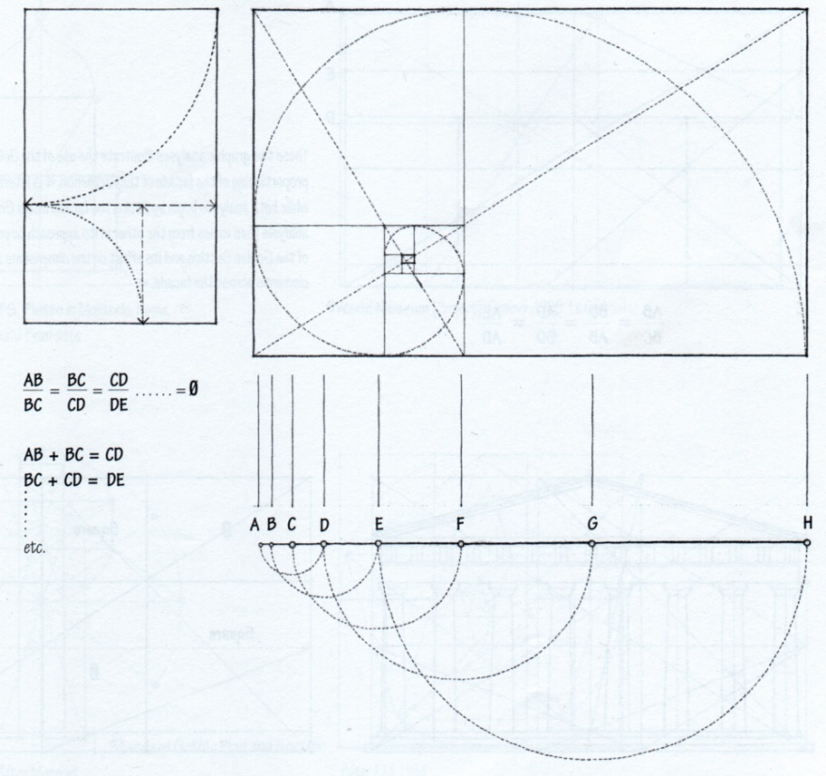
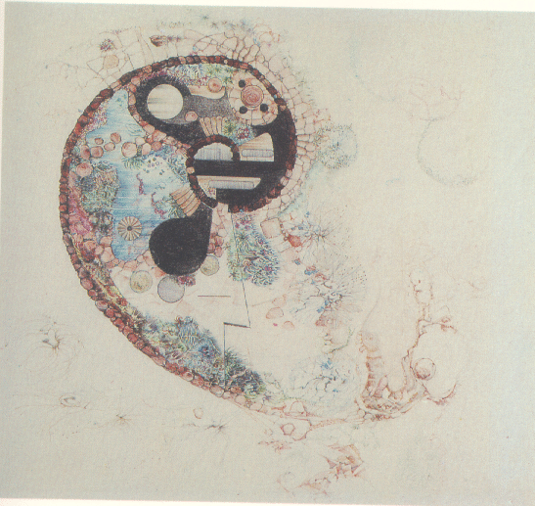
Design Principles
Mathematical Proportion
Golden Rectangle
(Based on the Fibonacci series
1, 1, 2, 3, 5, 8, 14, 21…)
Mathematical relationships are used to create proportional relationships.

Slide 53
SCALE

Slide 54
LeCorbusier’s ‘Modular’ proportional system

Slide 55
The Modulor is an anthropometric scale of proportions devised by the Swiss-born architect Le Corbusier (1887–1965)
It was developed as a visual bridge between two incompatible scales, the Imperial system and the Metric system.
It is based on the height of an English man with his arm raised.

Slide 56
Leonardo da Vinci’s Vitruvian Man circa 1490 (10” x 14”)

Slide 57
This drawing provides the perfect example of Leonardo's keen interest in proportion. In addition, this picture represents a cornerstone of Leonardo's attempts to relate man to nature.

Slide 58
Leonardo da Vinci’s Vitruvian Man
The drawing is based on the correlations of ideal human proportions with mathematical geometry described by the ancient Roman architect Vitruvius in Book III of his treatise De Architectura.
Vitruvius described the human figure as being the principal source of proportion among the Classical orders of architecture.
This image exemplifies the blend of art and science during the Renaissance and Leonardo’s interest in proportion.

Slide 59
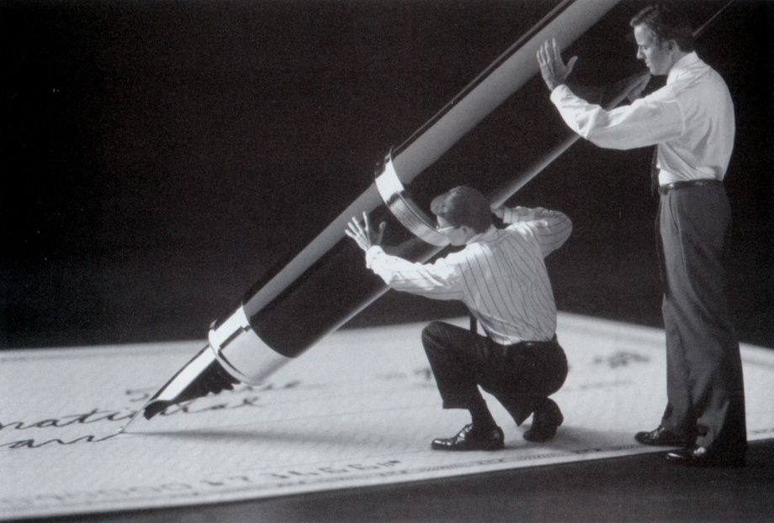
Design Principles
Scale
Scale is related to proportion.
Both scale and proportion relate to the relative size of objects and environmental elements.
Scale refers to a known standard such as the human body.

Slide 60
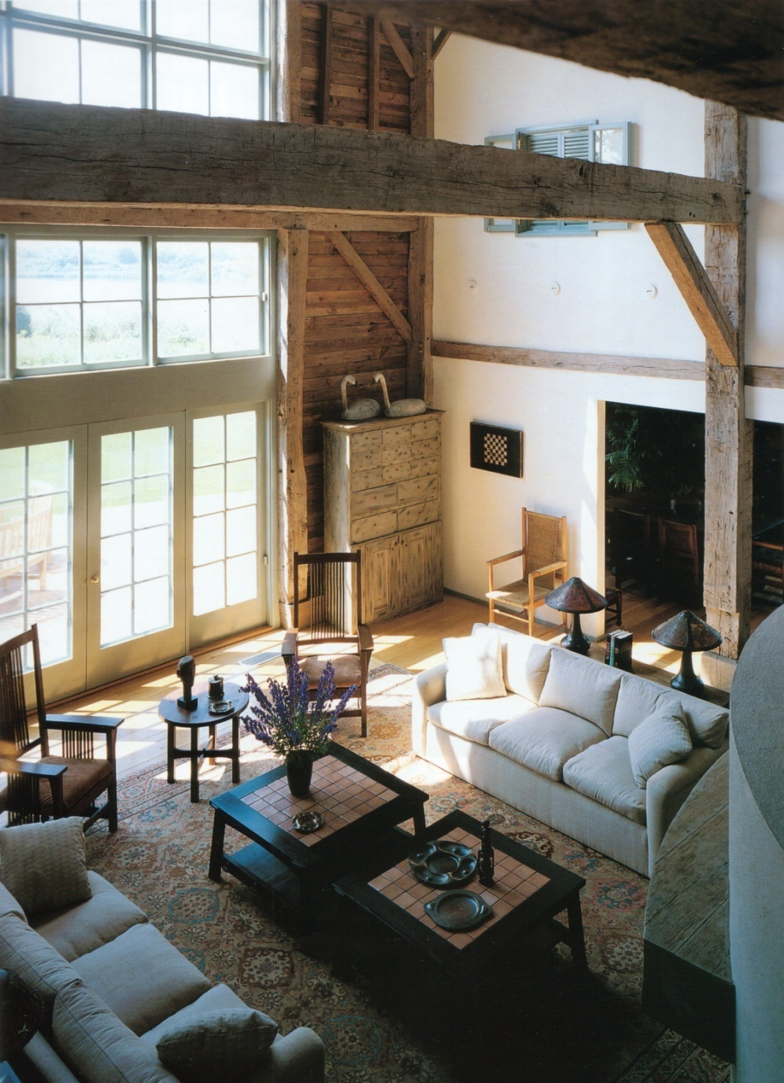
Design Principles
Scale
Scale relates to both space and objects.
Furnishings have scale relationships between each other.
Space has scale related to the human body and adjacent spaces.

Slide 61
‘Bad’ Scale in an interior Why is this ‘bad’? (pattern is too large for the space)

Slide 62
Bad scale: pattern is too big for the space

Slide 63
Bad scale: space is too large for the sparse furnishing

Slide 64
A note about tv show interior design
Many of the television programs that show remakes of entire homes for very little money or rooms redone in hours, have fueled interest in interior design, but they present a false reality.
Many of the services and materials used on those shows were donated, which keeps costs down.
Those shows have piqued interest but done a great disservice to the industry, Mason says. "They are not realistic.”
Bridget A. Otto, The Oregonian (newspaper)

Slide 65
Space and Scale – A space is experienced based on the relationship between the size (scale) of the space and the size (scale) of the human body.

Slide 66
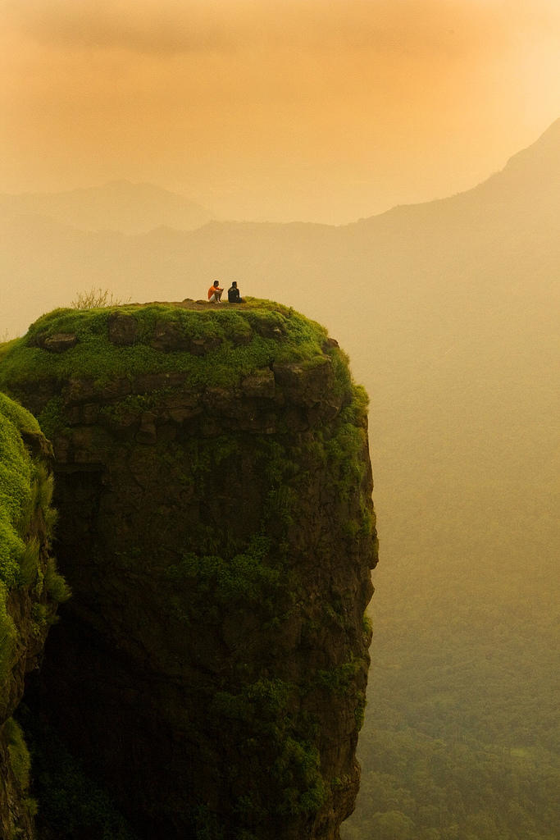
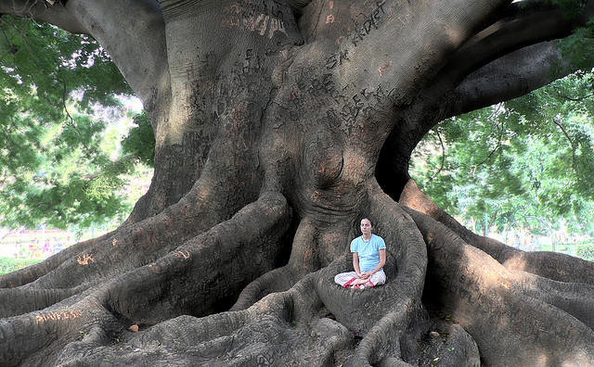
Scale
The size of the human body is the standard in which the space is measured.

Slide 67
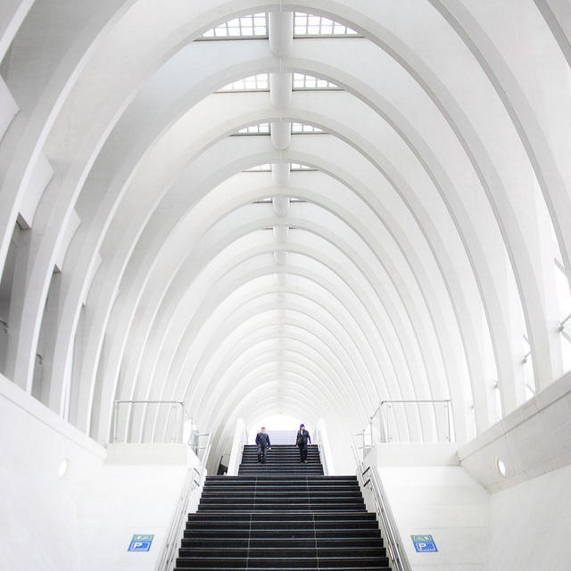
Tiny humans or Huge space?

Slide 68
What is the size of these light fixtures?

Slide 69
Pendant light fixtures are ‘human scale’ (unexpectedly large for a light fixture)

Slide 70
“Designed by Bruno Munari in 1964, this original custom design became a modern-day classic.
The Falkland Pendant Lamp features a tubular metal frame and aluminum structure, with an elastic fabric shade

Slide 71
‘Eco House’ scaled to fit the way a person actually lives

Slide 72
An architect-created green house plan that was designed from the ground up to be energy efficient and environmentally friendly.
The inspiration for the plan came from a growing awareness that new houses were getting bigger and bigger but with little redeeming design merit.
The problem is that comfort has almost nothing to do with how big a space is. It is attained, rather, by tailoring our houses to fit the way we really live, and to the scale and proportions of our human form.

Slide 74
Scale, proportion, balance, harmony, emphasis

Slide 75
BALANCE

Slide 76
Design Principles
Balance
Balance is a relationship of equilibrium between objects.
This includes color, shape, size, and texture.
Symmetrical Balance
Radial Balance
Asymmetrical Balance

Slide 77
Design Principles
Balance
Balance has an implied axis.
Symmetrical Balance is identical in imagery in reverse.

Slide 78
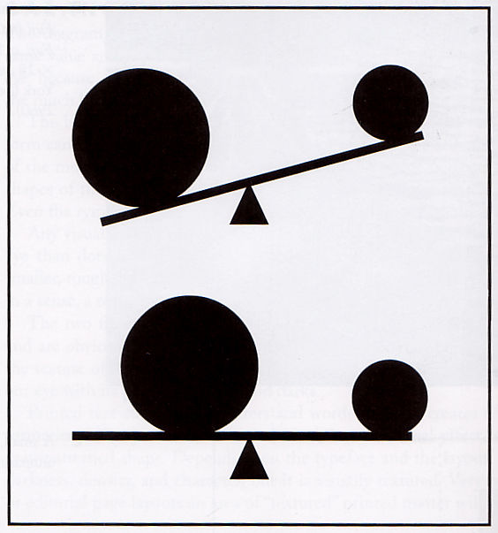
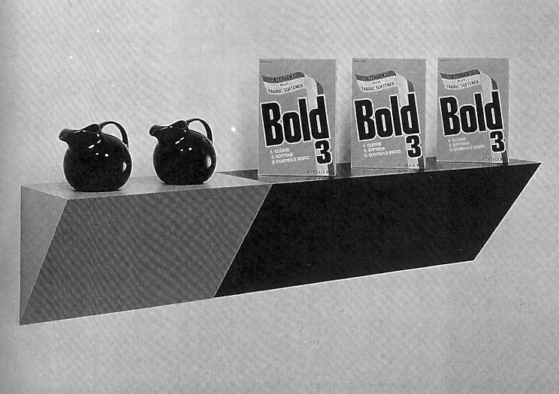
Design Principles
Balance
Asymmetrical balance is not the same but provides visual equilibrium.

Slide 79
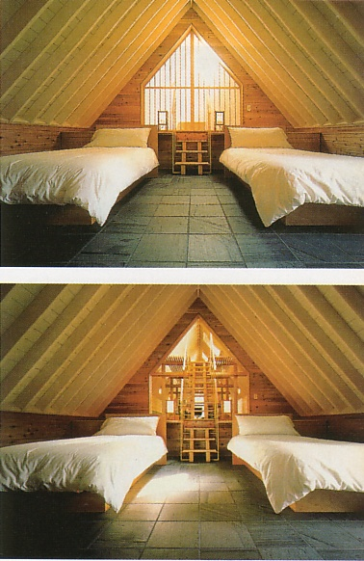
Design Principles
Balance
Symmetrical Balance can create a visual focal point for interest and emphasis.

Slide 80
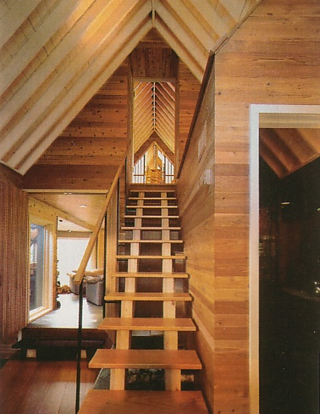
Design Principles:
Balance
Asymmetrical Balance is dependent upon a composed variety of shapes, colors, and textures.

Slide 81
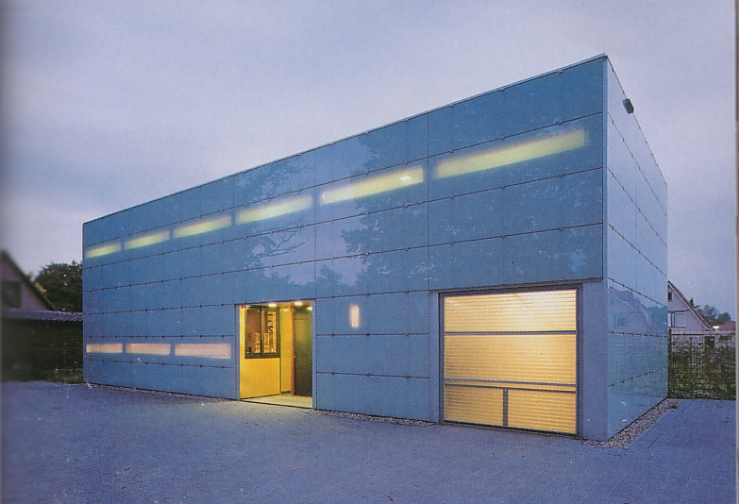
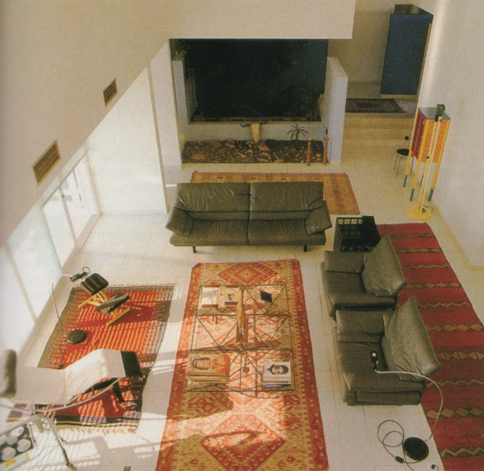
Design Principles
Balance
Asymmetrical Balance is not as easily recognized as symmetrical. But it is visually more dynamic and provides greater flexibility in the design.

Slide 82
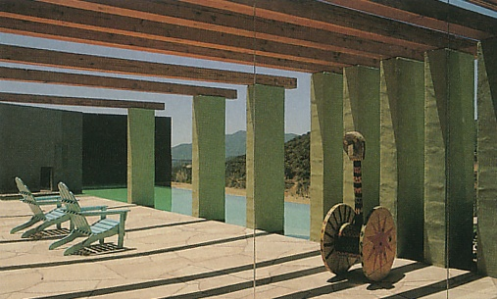
Design Principles
Harmony and Variety
Harmony is a process that combines elements and characteristics that are similar.
Harmony could result from using similar:
Size
Color
Shape
Materials
Orientation
Totally harmonious design would be monotonous and become static, uninteresting and boring. Variety is introduced to provide interest and visual relief.
Design can be thought of as “Sameness tempered with difference.”

Slide 83
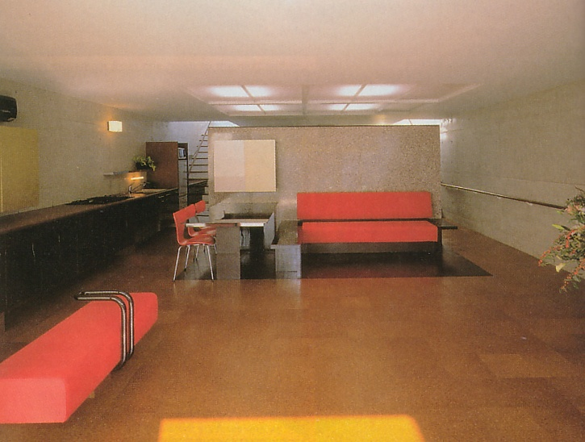
Design Principles
Harmony and Variety
Harmonious Elements
Color
Variety Elements
Shape

Slide 84
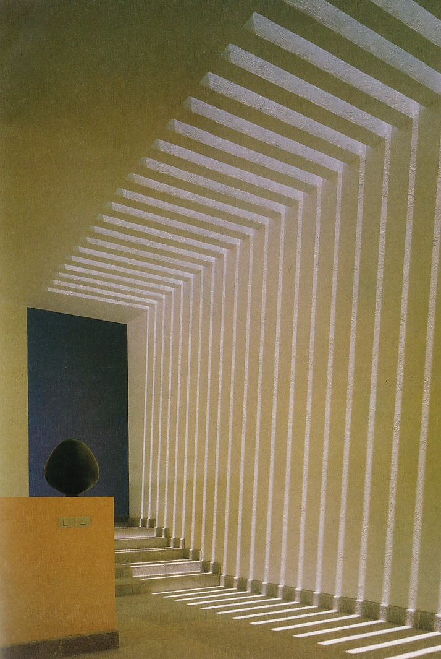
Design Principles
Harmony and Variety
Harmonious Elements
Shape
Orientation
Variety Elements
Form (vase)
Color (black vase)

Slide 85
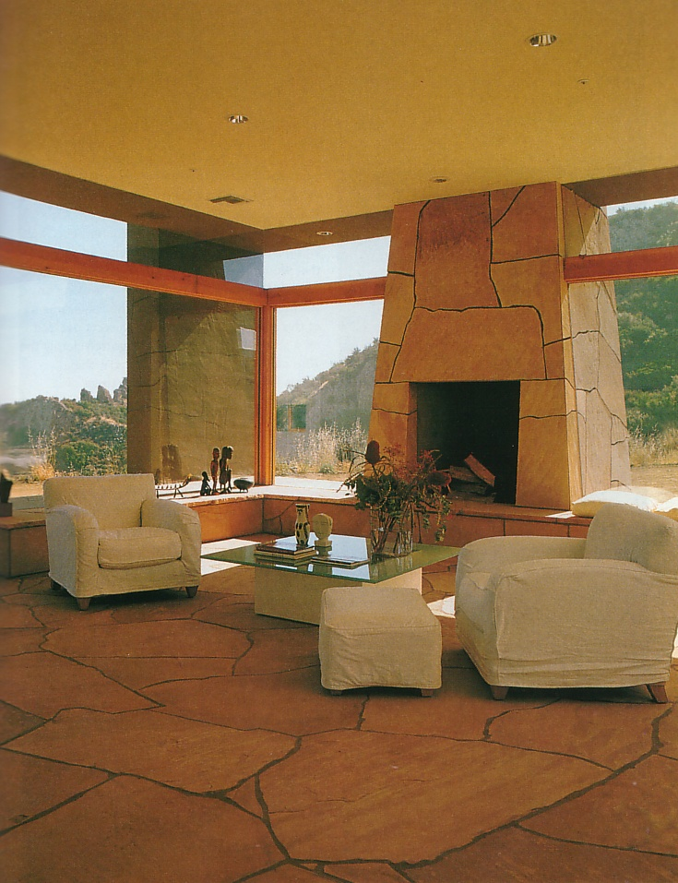
Design Principles
Harmony and Variety
Harmonious Elements
Materials (Floor and Fire Place, and Furniture)
Variety Elements
Texture (Floor and Textiles)

Slide 86
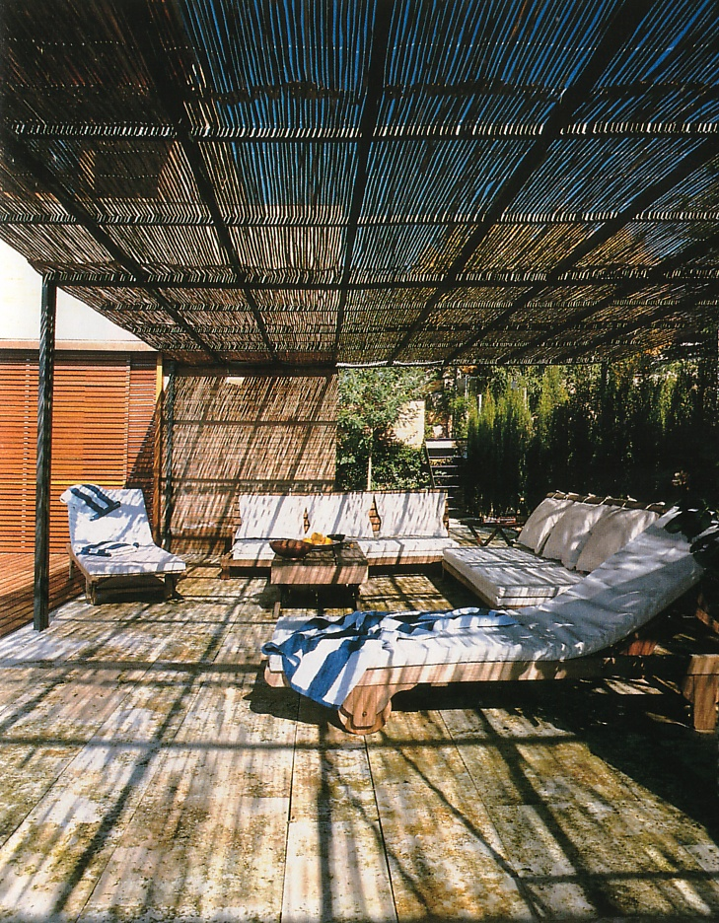
Design Principles
Harmony and Variety
Harmonious Elements
Orientation
Pieces are organized in relation to each other
Variety Elements
Materials (textiles and sticks)
Shape (Line and Mass)

Slide 87
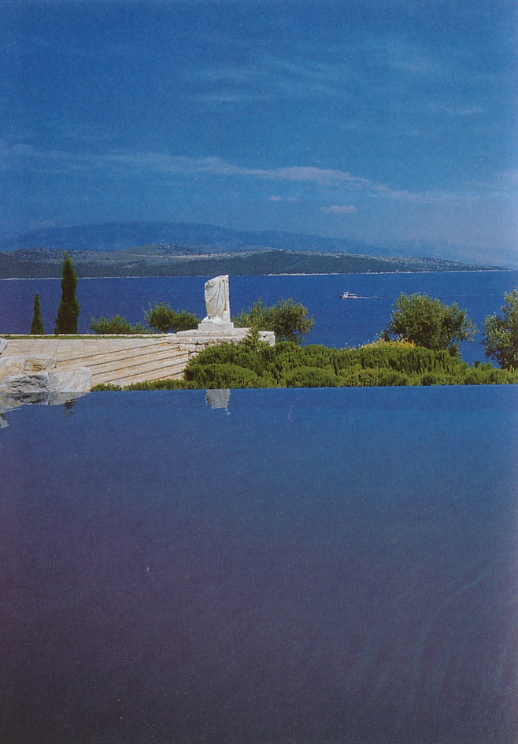
Design Principles
Harmony and Variety
Harmonious Elements
Materials (Water)
A narrow and coherent color ‘palette’
Variety Elements
Material (Stone)
Color (blue, green and white)

Slide 88
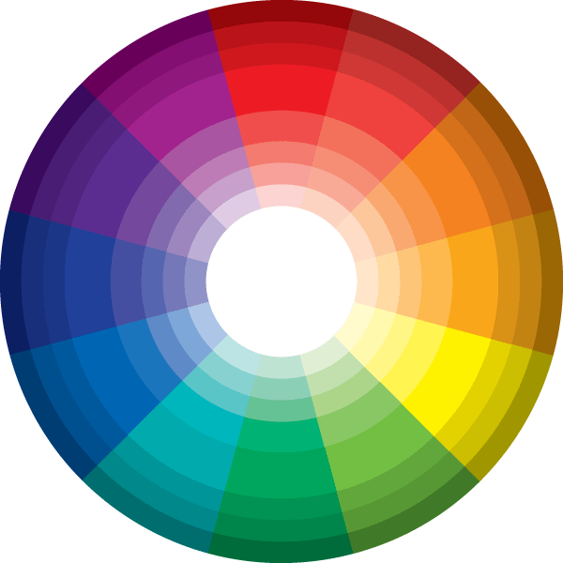
Color palette: a selected set of colors that exhibit a specific relationship to each other.
A classic ‘color palette’ is analogous colors: colors next to each other on the color wheel.

Slide 89
Design Principles
Harmony and Variety
Harmonious Elements
Boundary: edges, lines
Variety Elements
Pattern

Slide 90
Design Principles
Rhythm
Rhythm is bases on repetition of elements in space and time.
Regular “repetitive” spacing of elements can be monotonous and static.
Variety on proximity of elements can make a more visually interesting composition.

Slide 91
Design Principles
Rhythm
Rhythm in design is metaphorically linked to rhythm in music.

Slide 92
Design Principles
Rhythm
Rhythm can be found in nature.

Slide 93
Design Principles
Rhythm
Rhythm studies made with lines may suggest a link to emotions.

Slide 94
Design Principles
Rhythm
Rhythm can be found in architecture though structure, shadow, and reflection.

Slide 95
Design Principles
Rhythm
Rhythm can be found in architectural ornamentation.

Slide 96
Design Principles
Rhythm
Rhythm can be found in architectural elements such as stairs and windows.

Slide 97
Design Principles
Emphasis
The use of emphasis in design requires dominate and subordinate elements.
An example of emphasis using contrasting geometry and color to focus on the stair.

Slide 98
Design Principles
Emphasis
Change in direction of geometry can create emphasis.

Slide 99
Design Principles
Emphasis
Lighting can create a focal point of emphasis.
Termination of an axis is also a mode of emphasis.

Slide 100
Emphasis at a room scale

Slide 101
Emphasis at a room scale

Slide 102
Emphasis at an urban scale The design of this park (called the Champ de Mars) intentionally places emphasis upon the tower and the axis that runs between the palace and the military school.

Slide 103
Emphasis at an urban scale: created by using a strong axis

Slide 104
Library renovation in Vennesla, Norway designed by Norwegian architecture firm Helen & Hard

Slide 105
The newly renovated community complex in Vennesla, Norway boasts a clean, accessible, and energy-saving design, welcoming citizens to use the space.

Slide 106
With a strong emphasis on constructing an open and inviting public space, the structure features large glass windows to diminish the visible barrier between the indoors and outdoors, allowing the cityscape to seamlessly converge with the urban motifs of the interior design.

Slide 107
Inside, there is a rib pattern providing ample room for shelving.

Slide 108
The library features 27 ribs made of prefabricated glue-laminated timber beams and columns, CNC cut plywood boards, acoustic absorbents that contain the air conditioning ducts, and bent glass panes to serve as lighting covers.

Slide 109
The gradual shift in length and size of each shelf accommodates the irregular shape of the space while adding a modern and spacious aesthetic appeal.

Slide 110
Small scale, private, space within the larger, public, interior environment.

Slide 111
To be able to see the interior and the exterior at once creates a holistic sense, a ‘gestalt’ (the whole is greater than the sum of the parts).

Slide 115
Design Principles
Emphasis is created by using:
Shapes
Sizes
Location
Color
Material
Lighting

Slide 116
Design Principles
Creating Patterns in Space With:
Proportion
Scale
Balance
Harmony
Unity and Variety
Rhythm
Emphasis
Each of these characteristics work with others to make a coherent whole.

